Slide 1
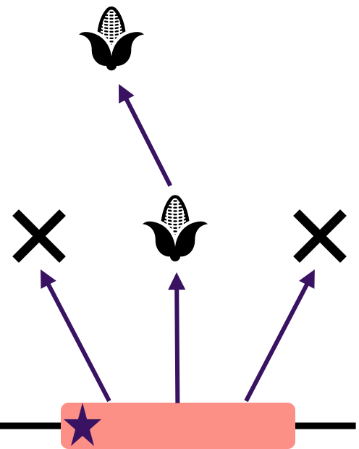


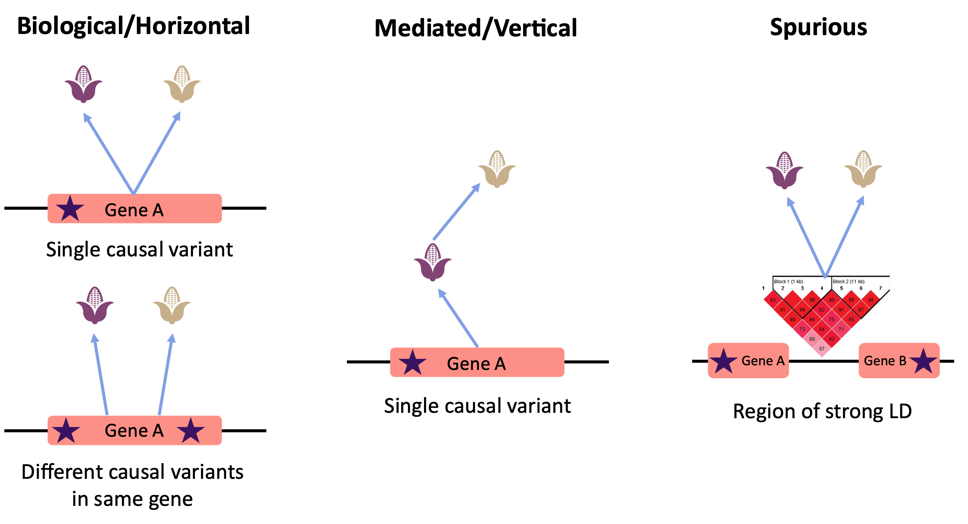
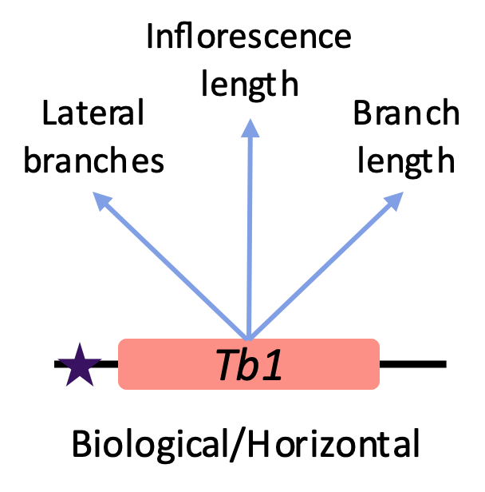
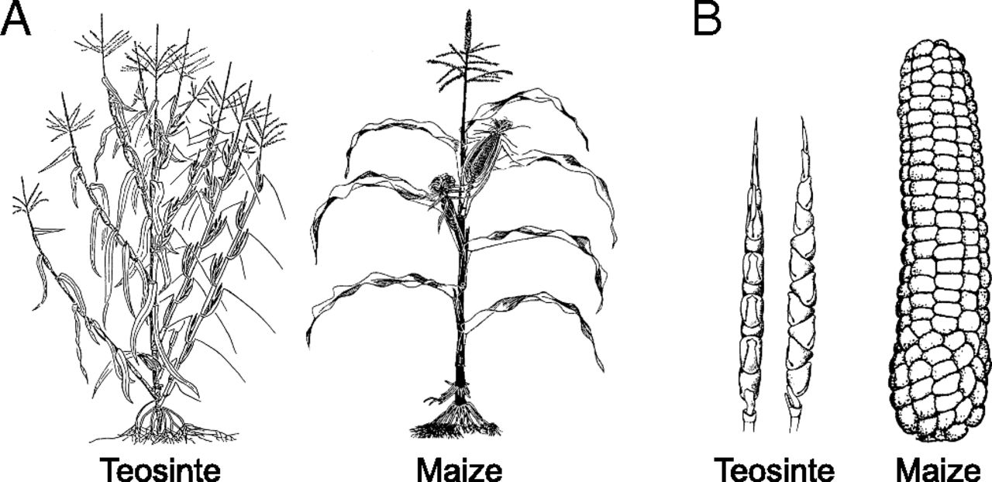
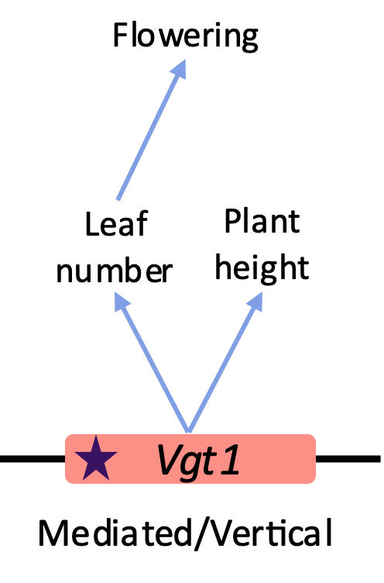
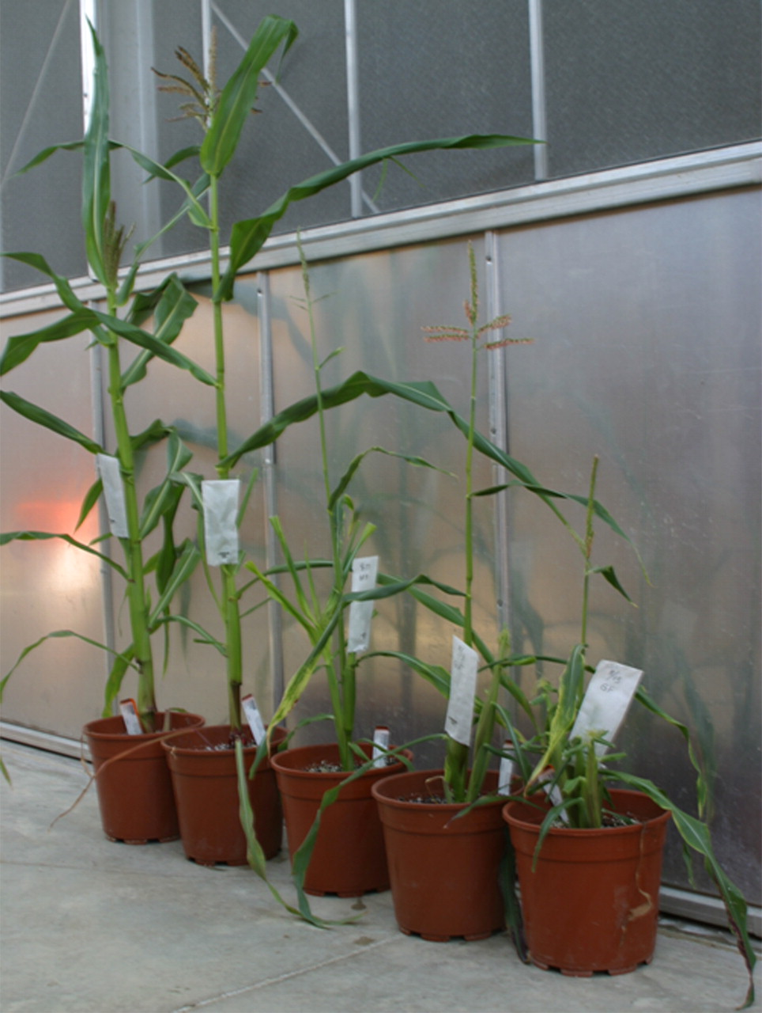
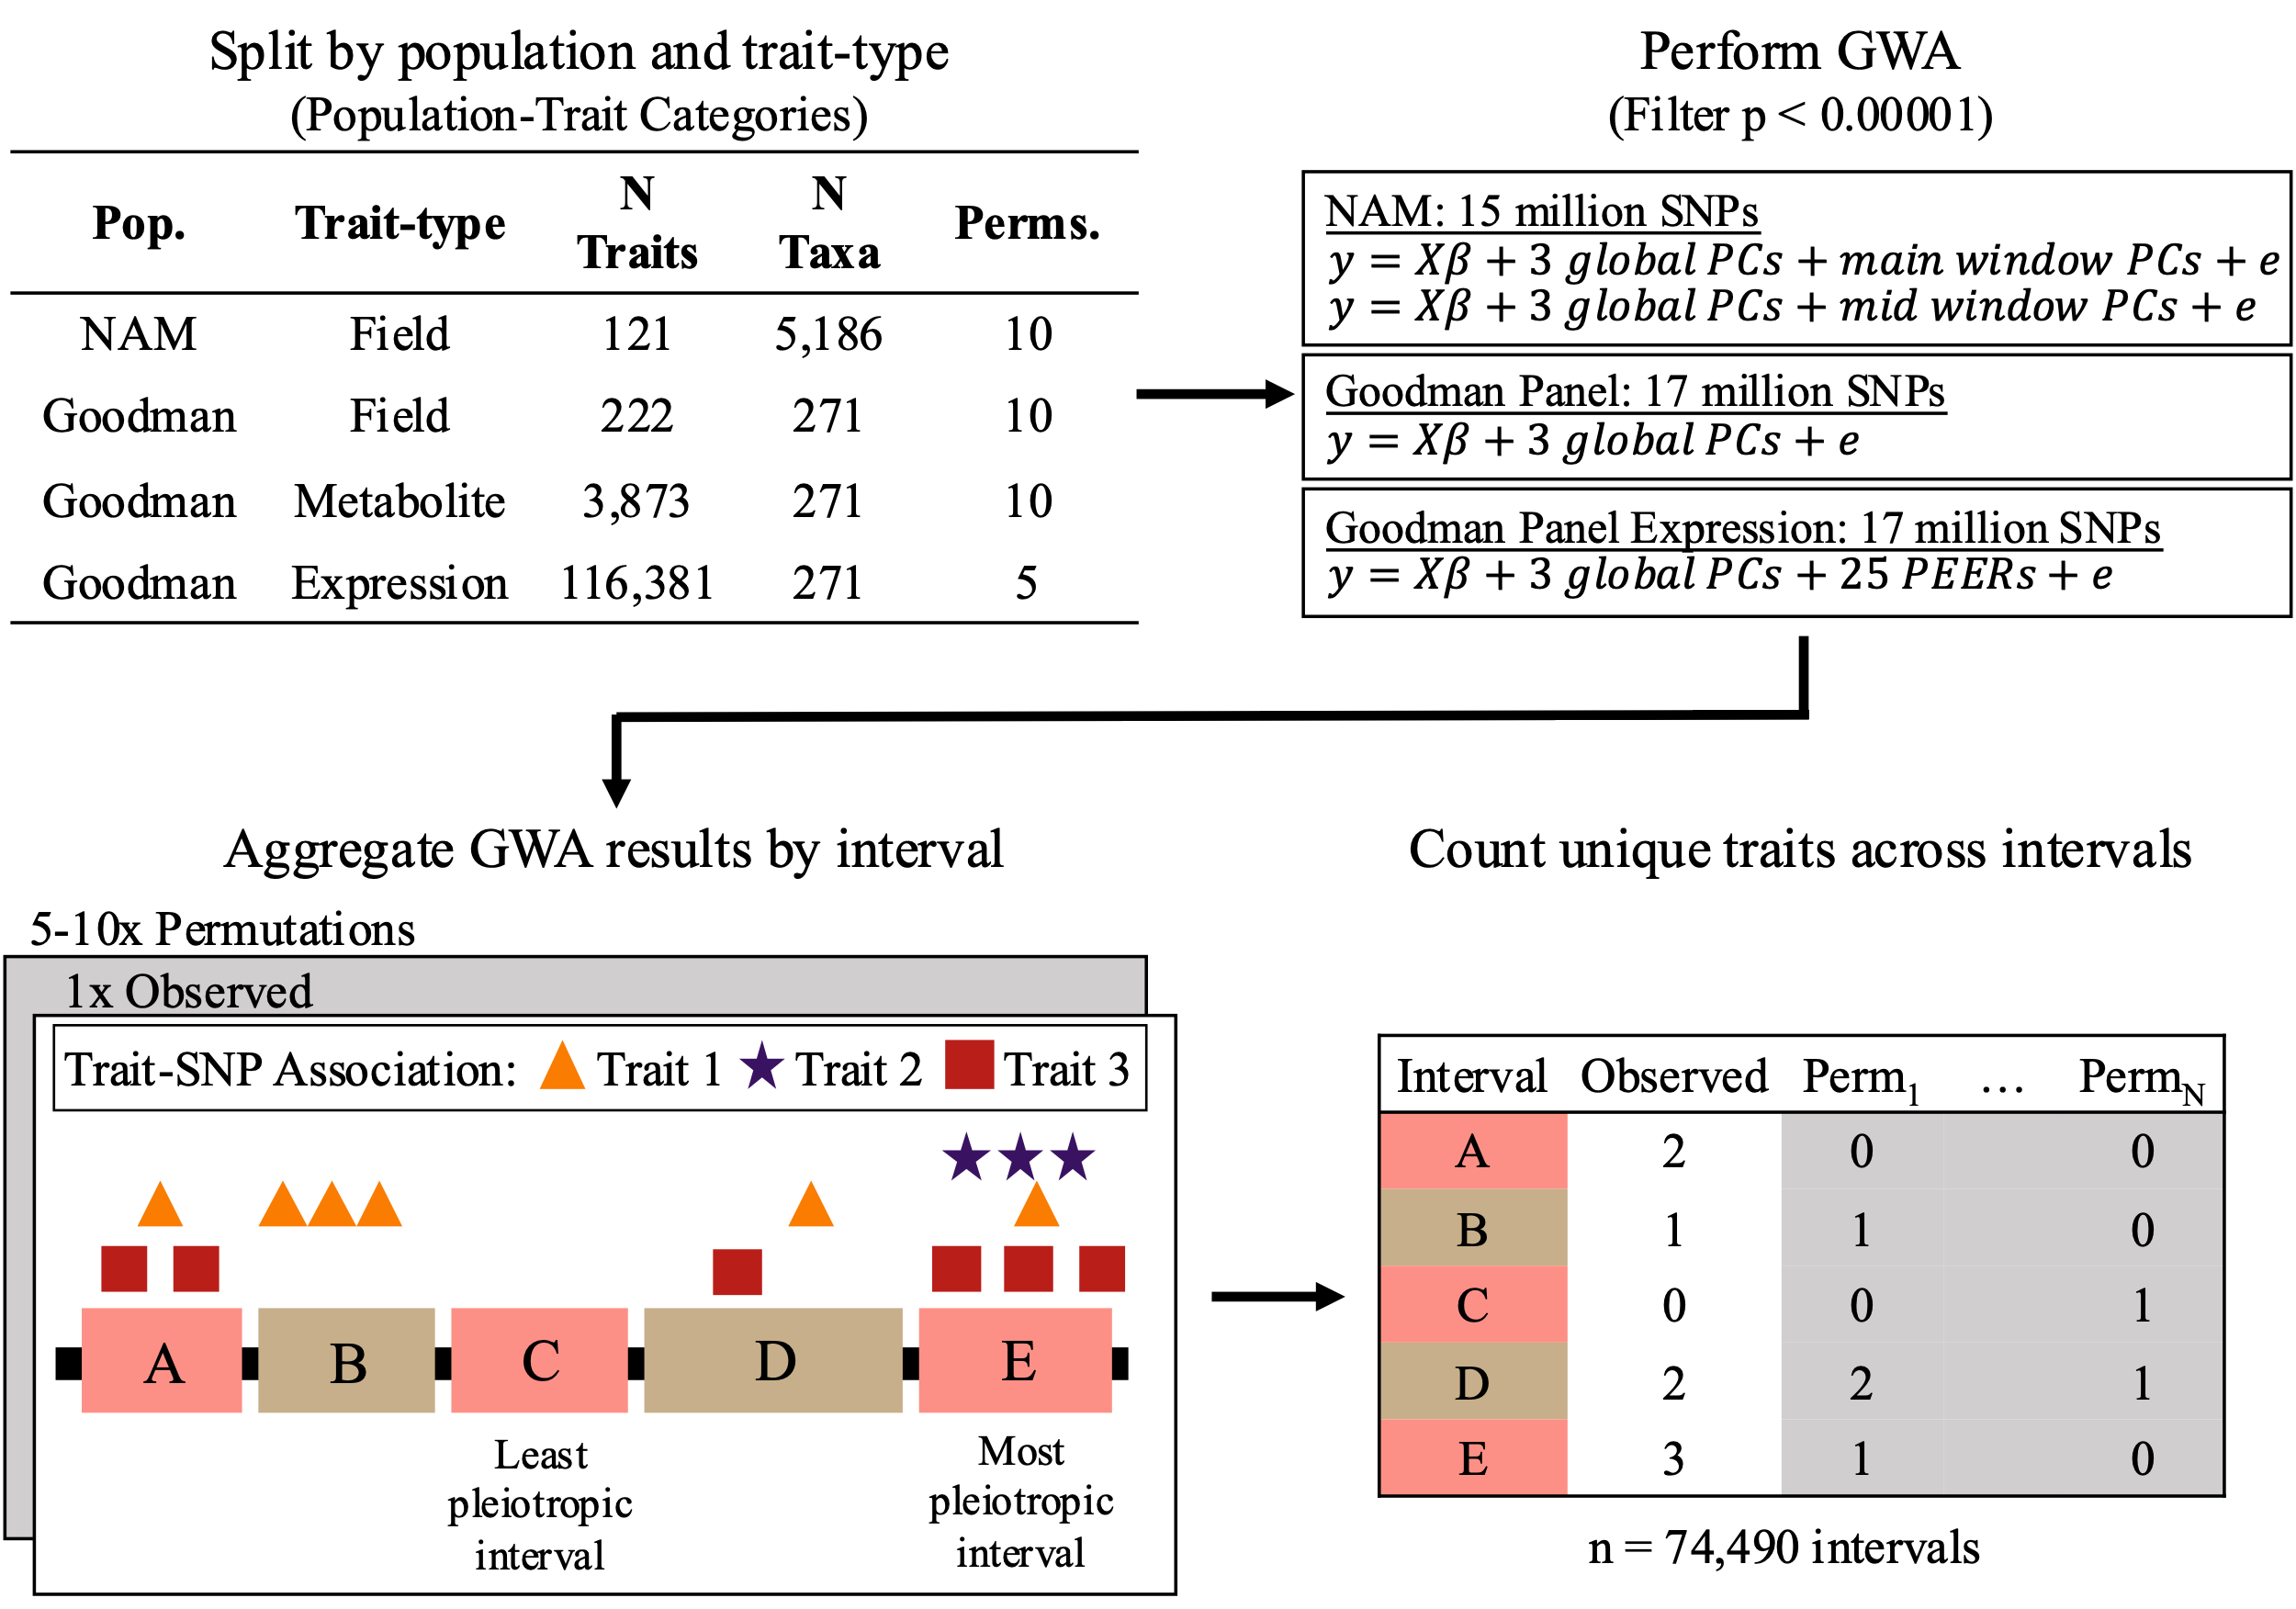
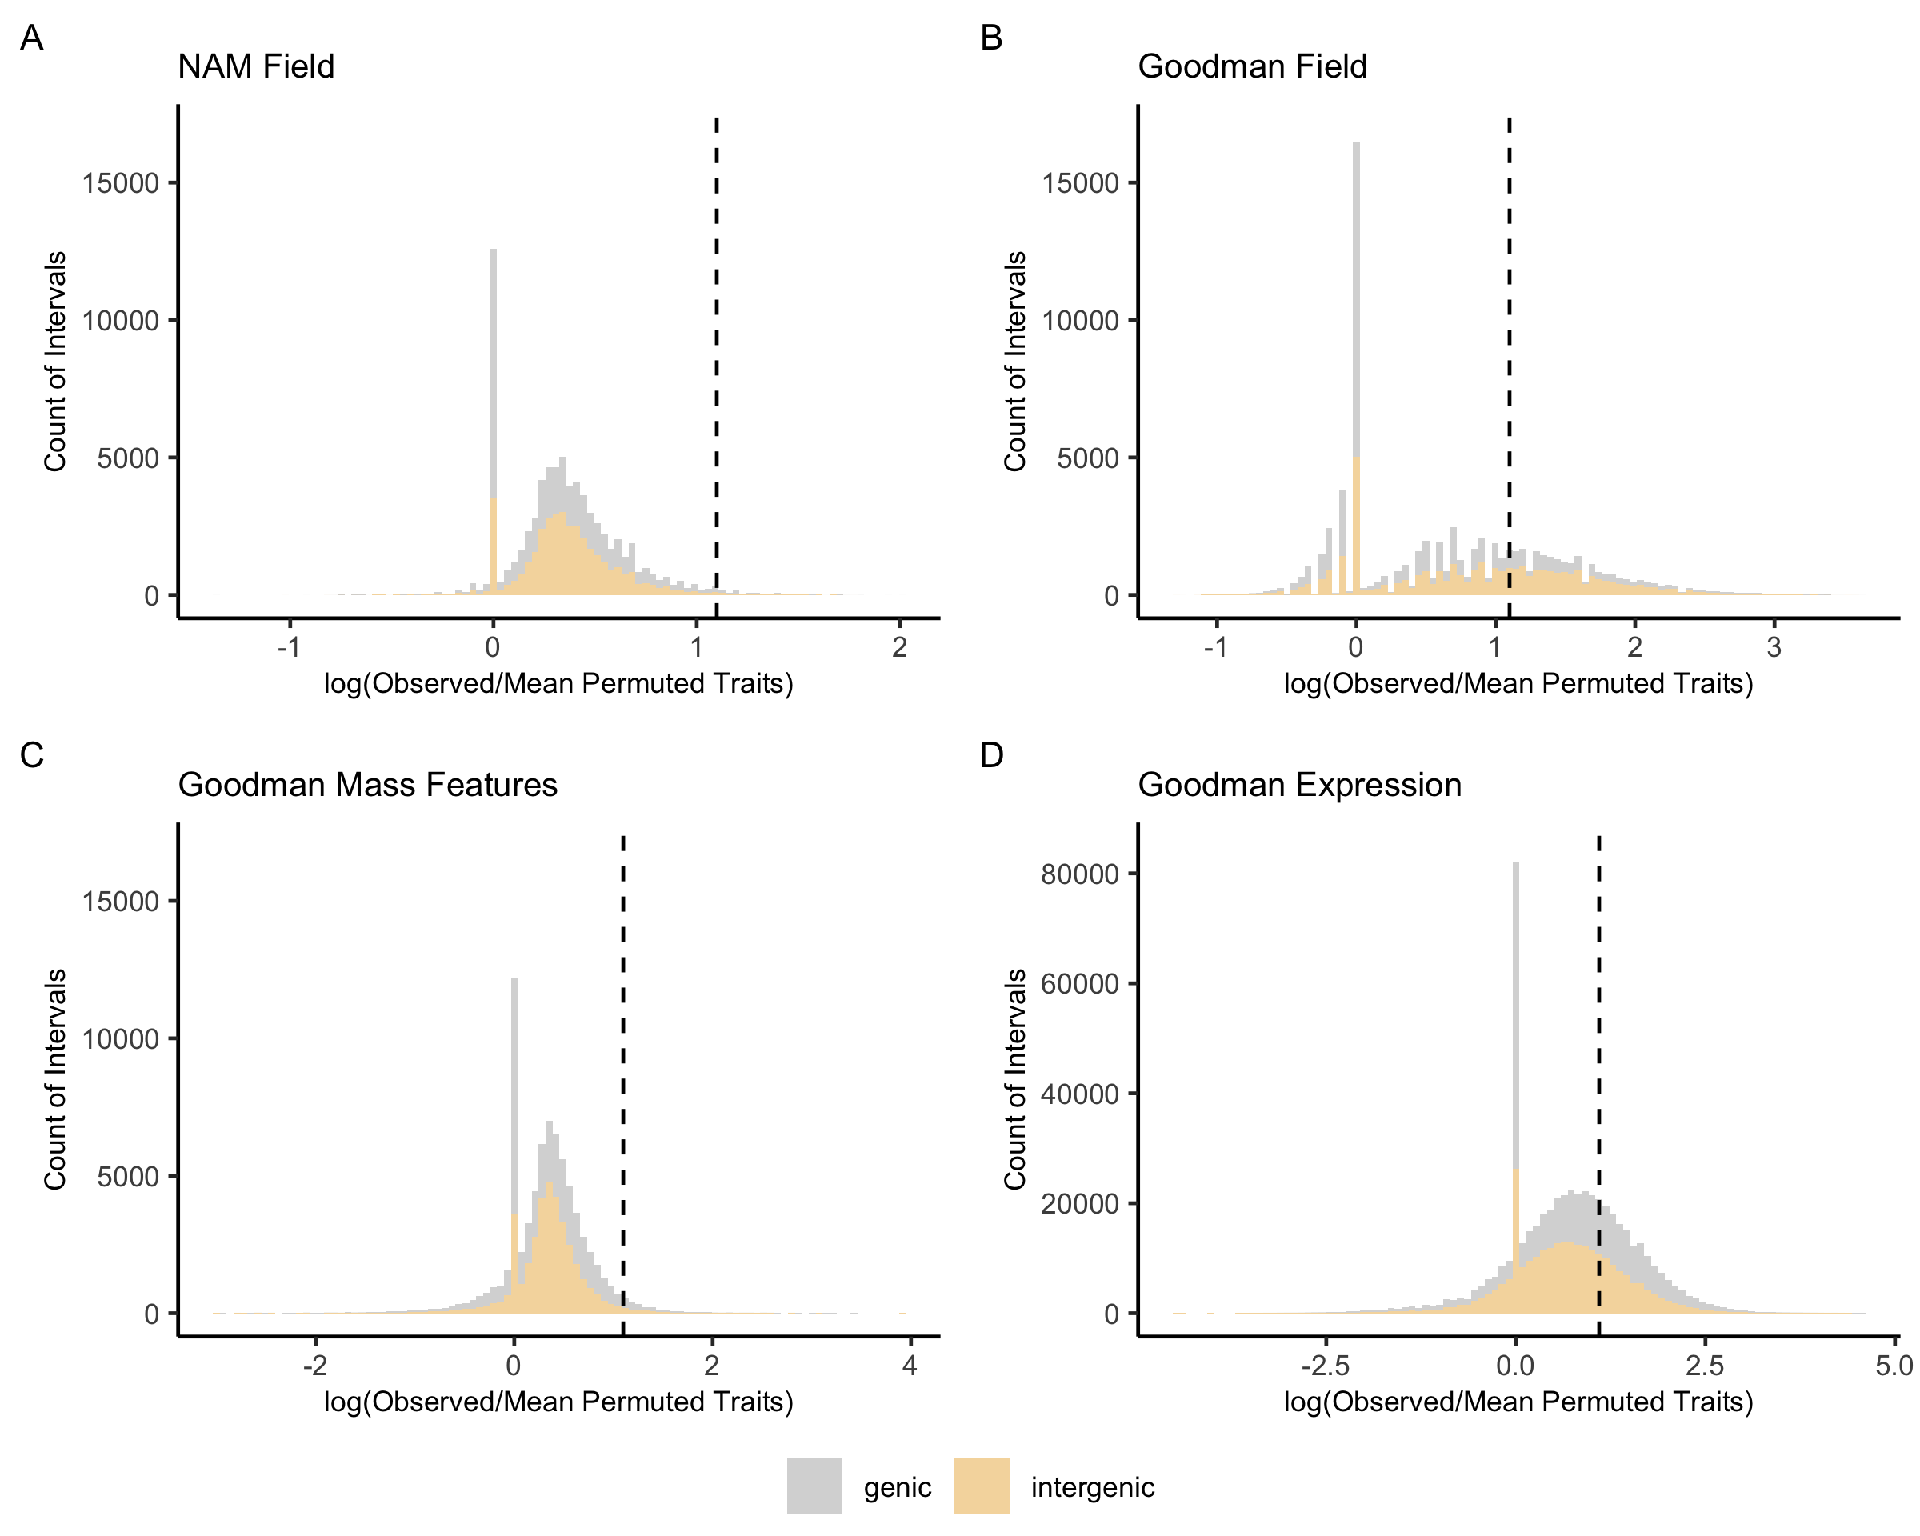

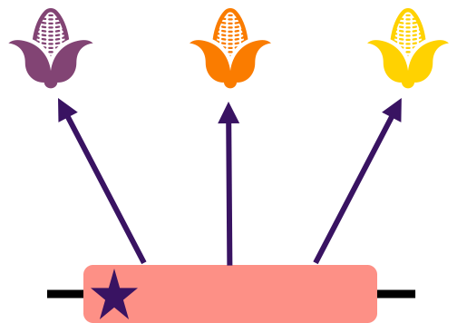
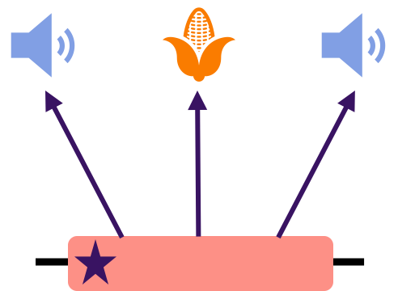
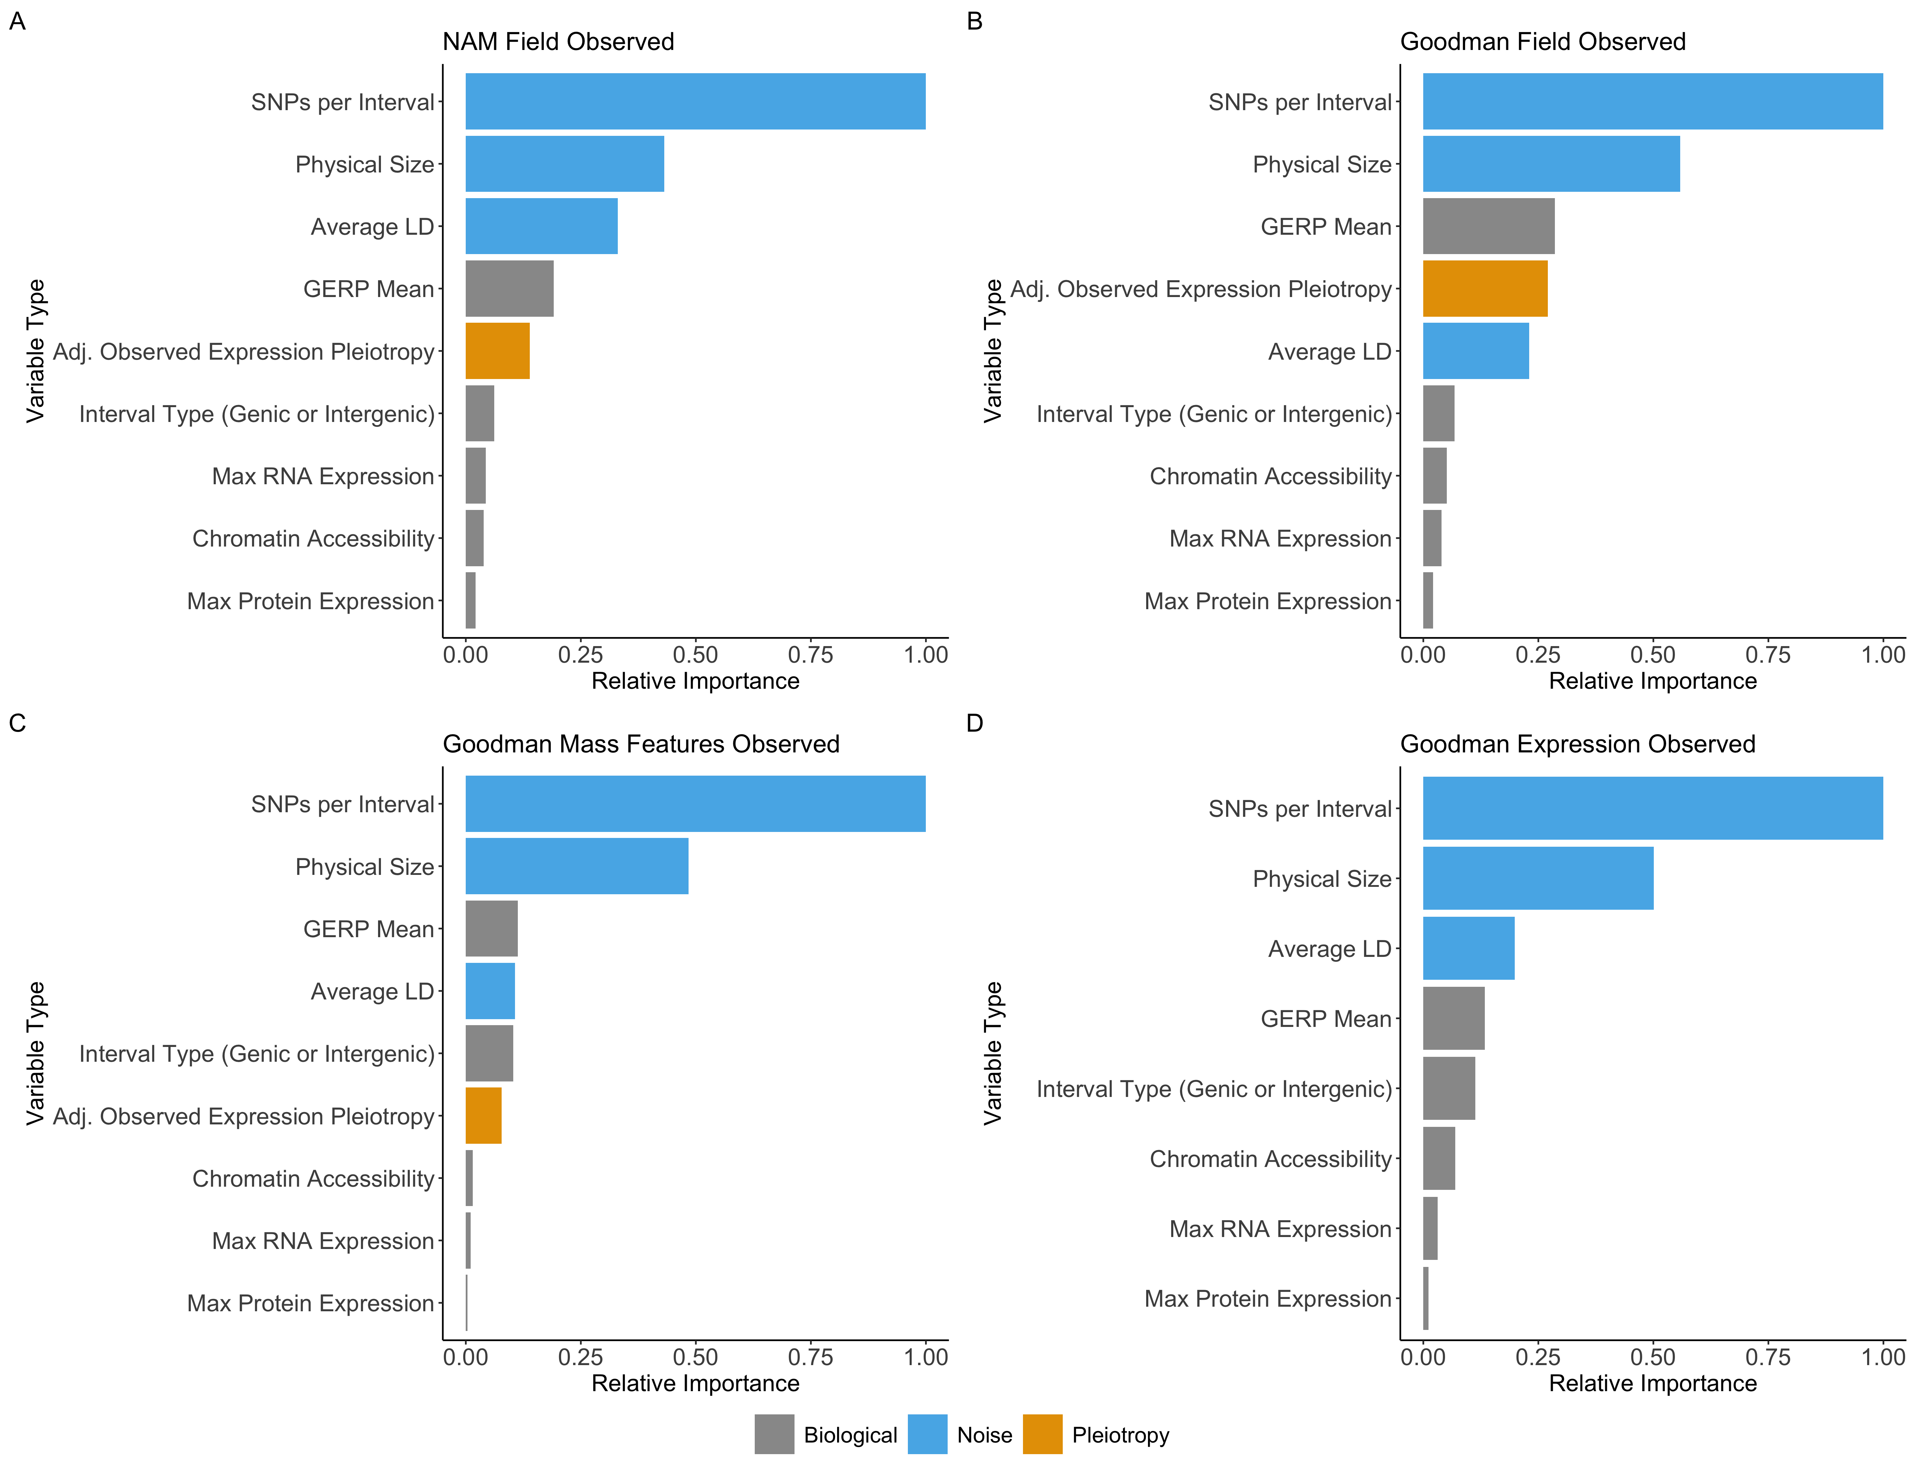
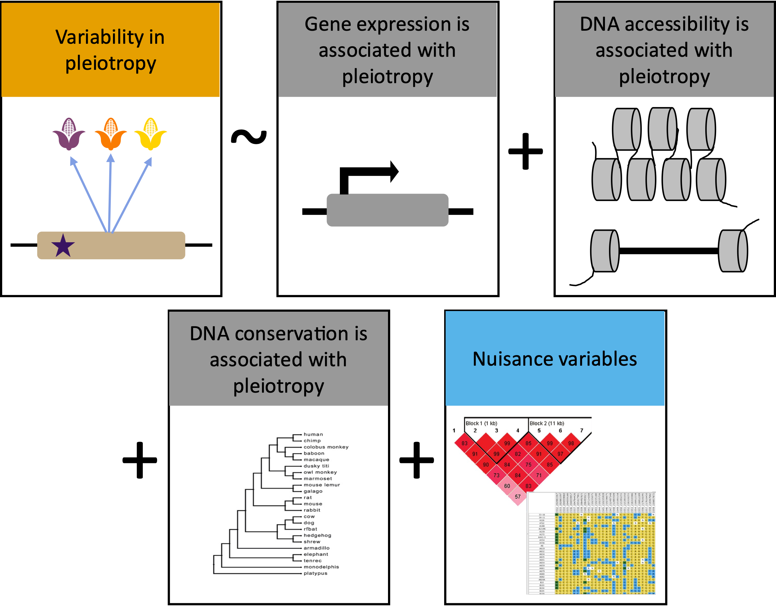
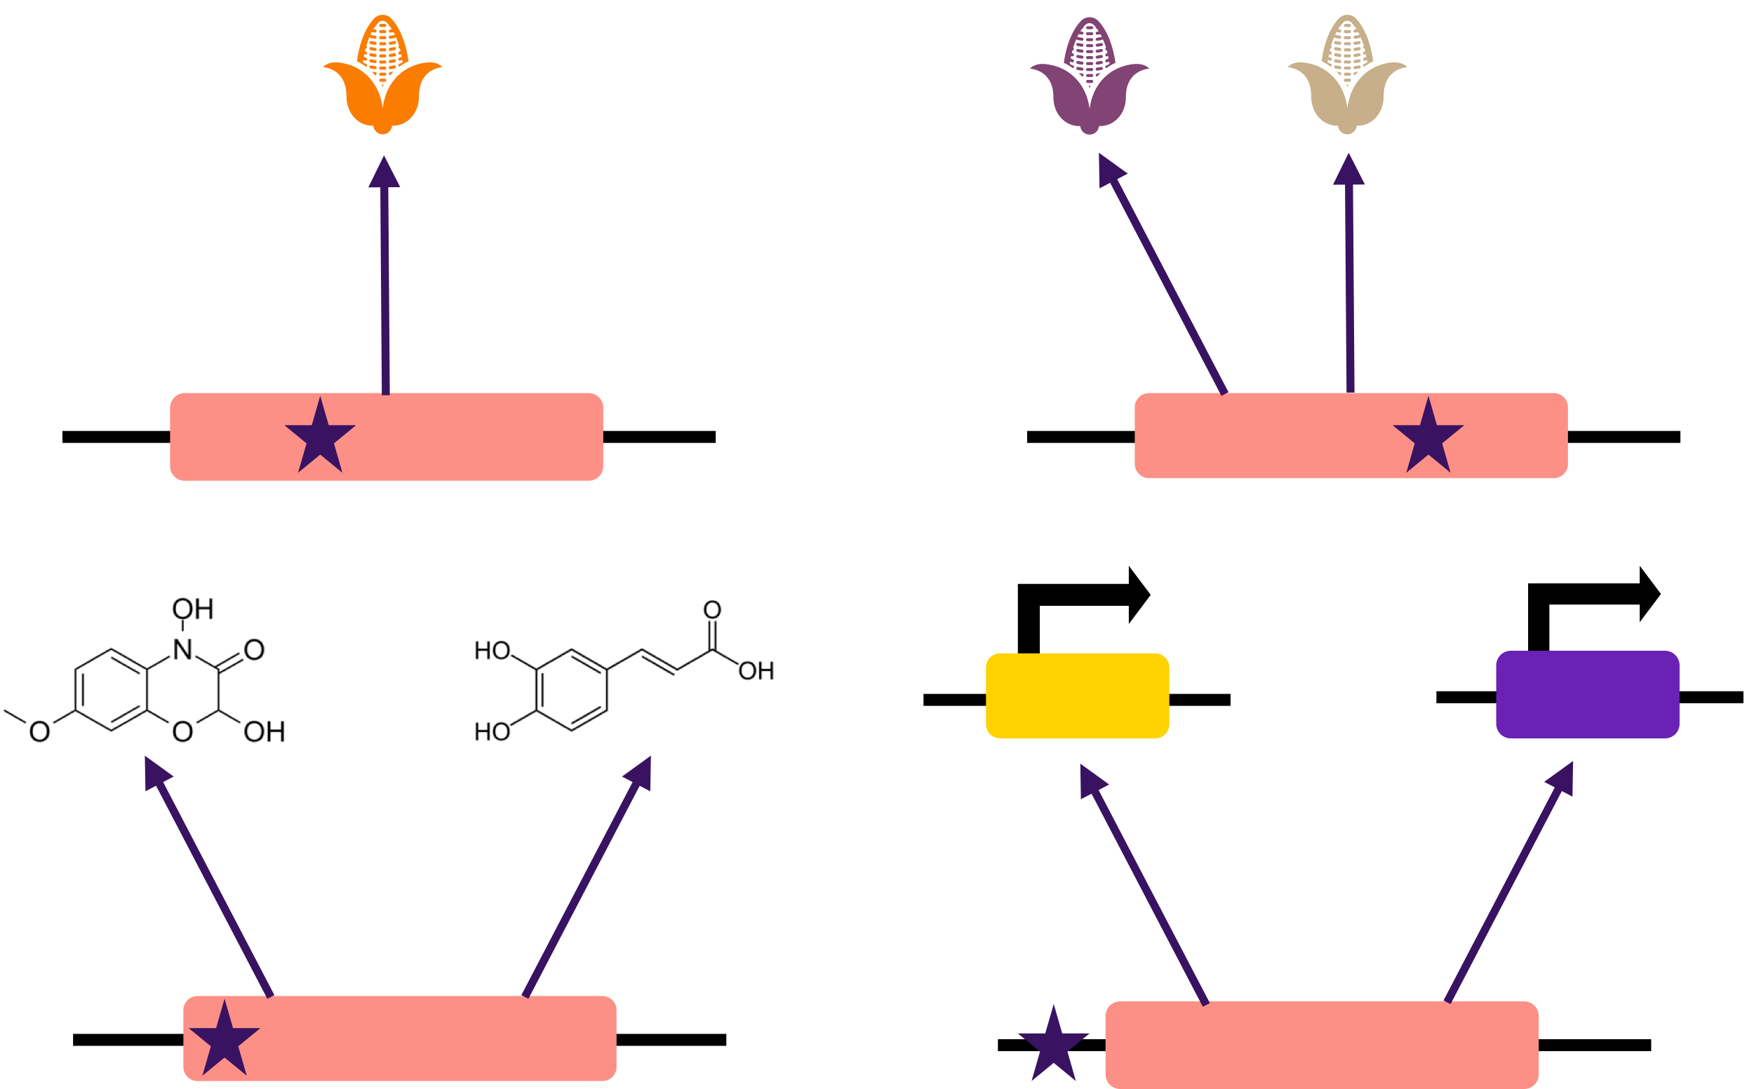
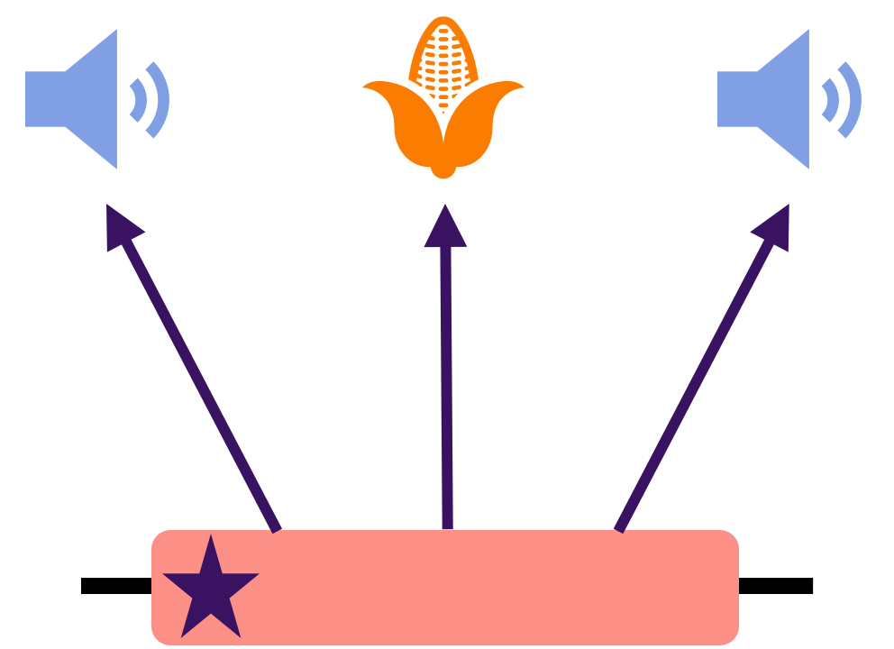




Elucidating the patterns of pleiotropy and its biological relevance in maize
mbb262@cornell.edu
Merritt Khaipho-Burch ¹; Taylor Ferebee ²; Anju Giri ³; Guillaume Ramstein ^{3,4}; Brandon Monier ³; Emily Yi ³; M. Cinta Romay ³; Edward Buckler ^{1,3,5}
@MerKhaiBurch
1) Section of Plant Breeding and Genetics, Cornell University, Ithaca, NY; 2) Department of Computational Biology, Cornell University, Ithaca, NY; 3) Institute for Genomic Diversity, Cornell University, Ithaca, NY; 4) Center for Quantitative Genetics and Genomics, Aarhus University, Aarhus, Denmark; 5) USDA-ARS; Ithaca, NY
Pleiotropy: a single locus that affects multiple traits. How pleiotropic is any maize locus?
Many forms of pleiotropy exist:
Few examples of pleiotropy have been described and verified in maize:
Vegetative to generative transition 1
Yang et al., 2019
Salvi et al., 2007
GWAS on 120,597 field, metabolite, and expression traits uncovers the patterns of pleiotropy.
Less
Pleiotropy
More
Pleiotropy
Less
Pleiotropy
More
Pleiotropy
68-98% of intervals are involved with 0-1 traits.
98%
2%
68%
32%
2-31% of intervals are involved with 2+ traits.
97%
3%
69%
31%
Much of this observed pleiotropy may be spurious.
Random forest models show high importance for nuisance terms, low importance for biological terms.
The distribution of pleiotropy differs by population and trait.
Pleiotropy estimates are highly biased towards nuisance terms and investigator bias. Caution & validation should be applied.
Want to know more?
Take a FREE zine about this poster!
Legend :
Nuisance
Biological
Pleiotropy
Thank you to our funding sources: NSF PGRP: IOS#1822330, the USDA ARS, and the USDA NIFA AFRI Pre-doctoral fellowship: 2022-67011-36458.
Preprint coming soon!

